Slide 1
Understanding Our Bodies
4th Grade S.H.A.R.E.

Slide 2
Simon Says: Head, Shoulders, Knees and Toes…
We’re going to play a quick game of Simon Says
  Stand up
  When I say, Simons says point to____, point to the body part

Slide 3

Girls and people with a vulva
Boys and people with a penis

Slide 4
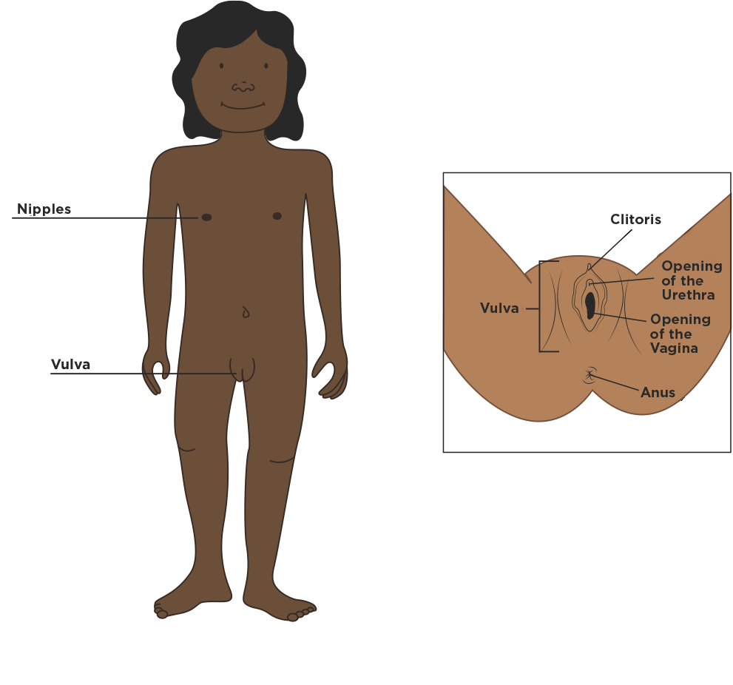
Girls and people with a vulva

Slide 5
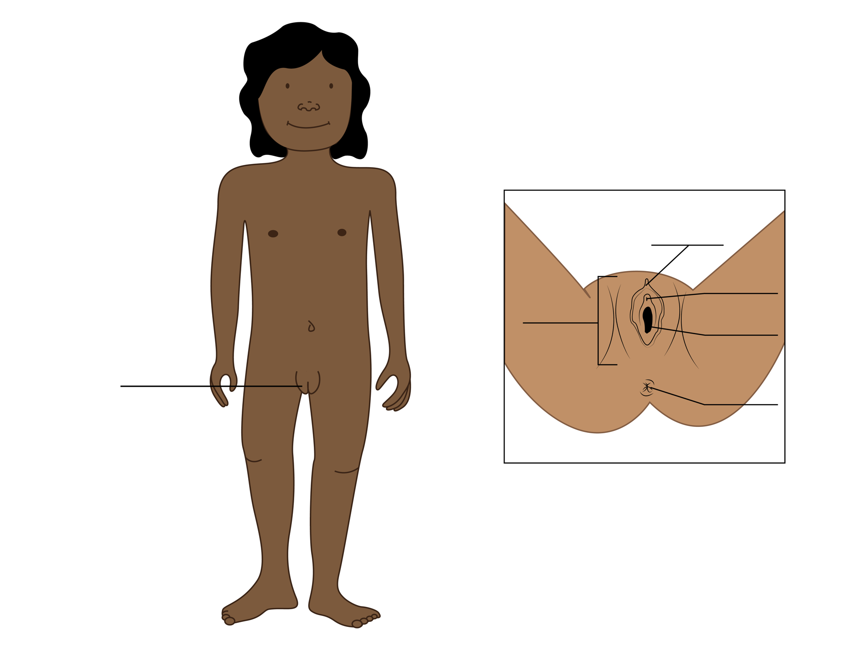
Girls and people with a vulva

Slide 6
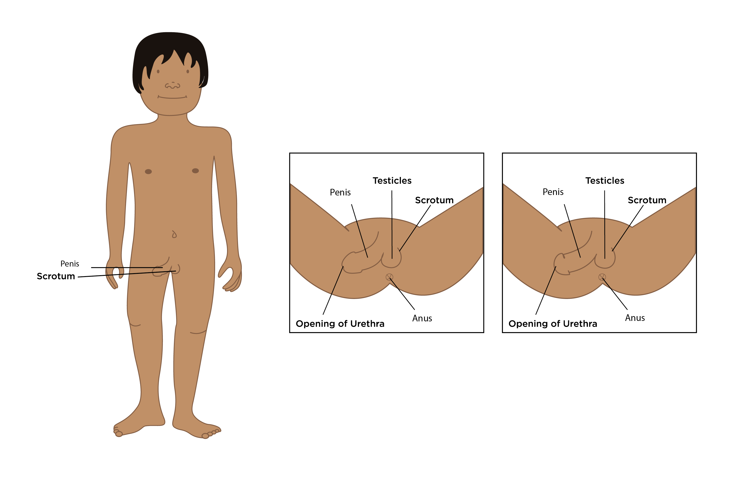
Boys and people with a penis
intact/uncircumcised
circumcised

Slide 7
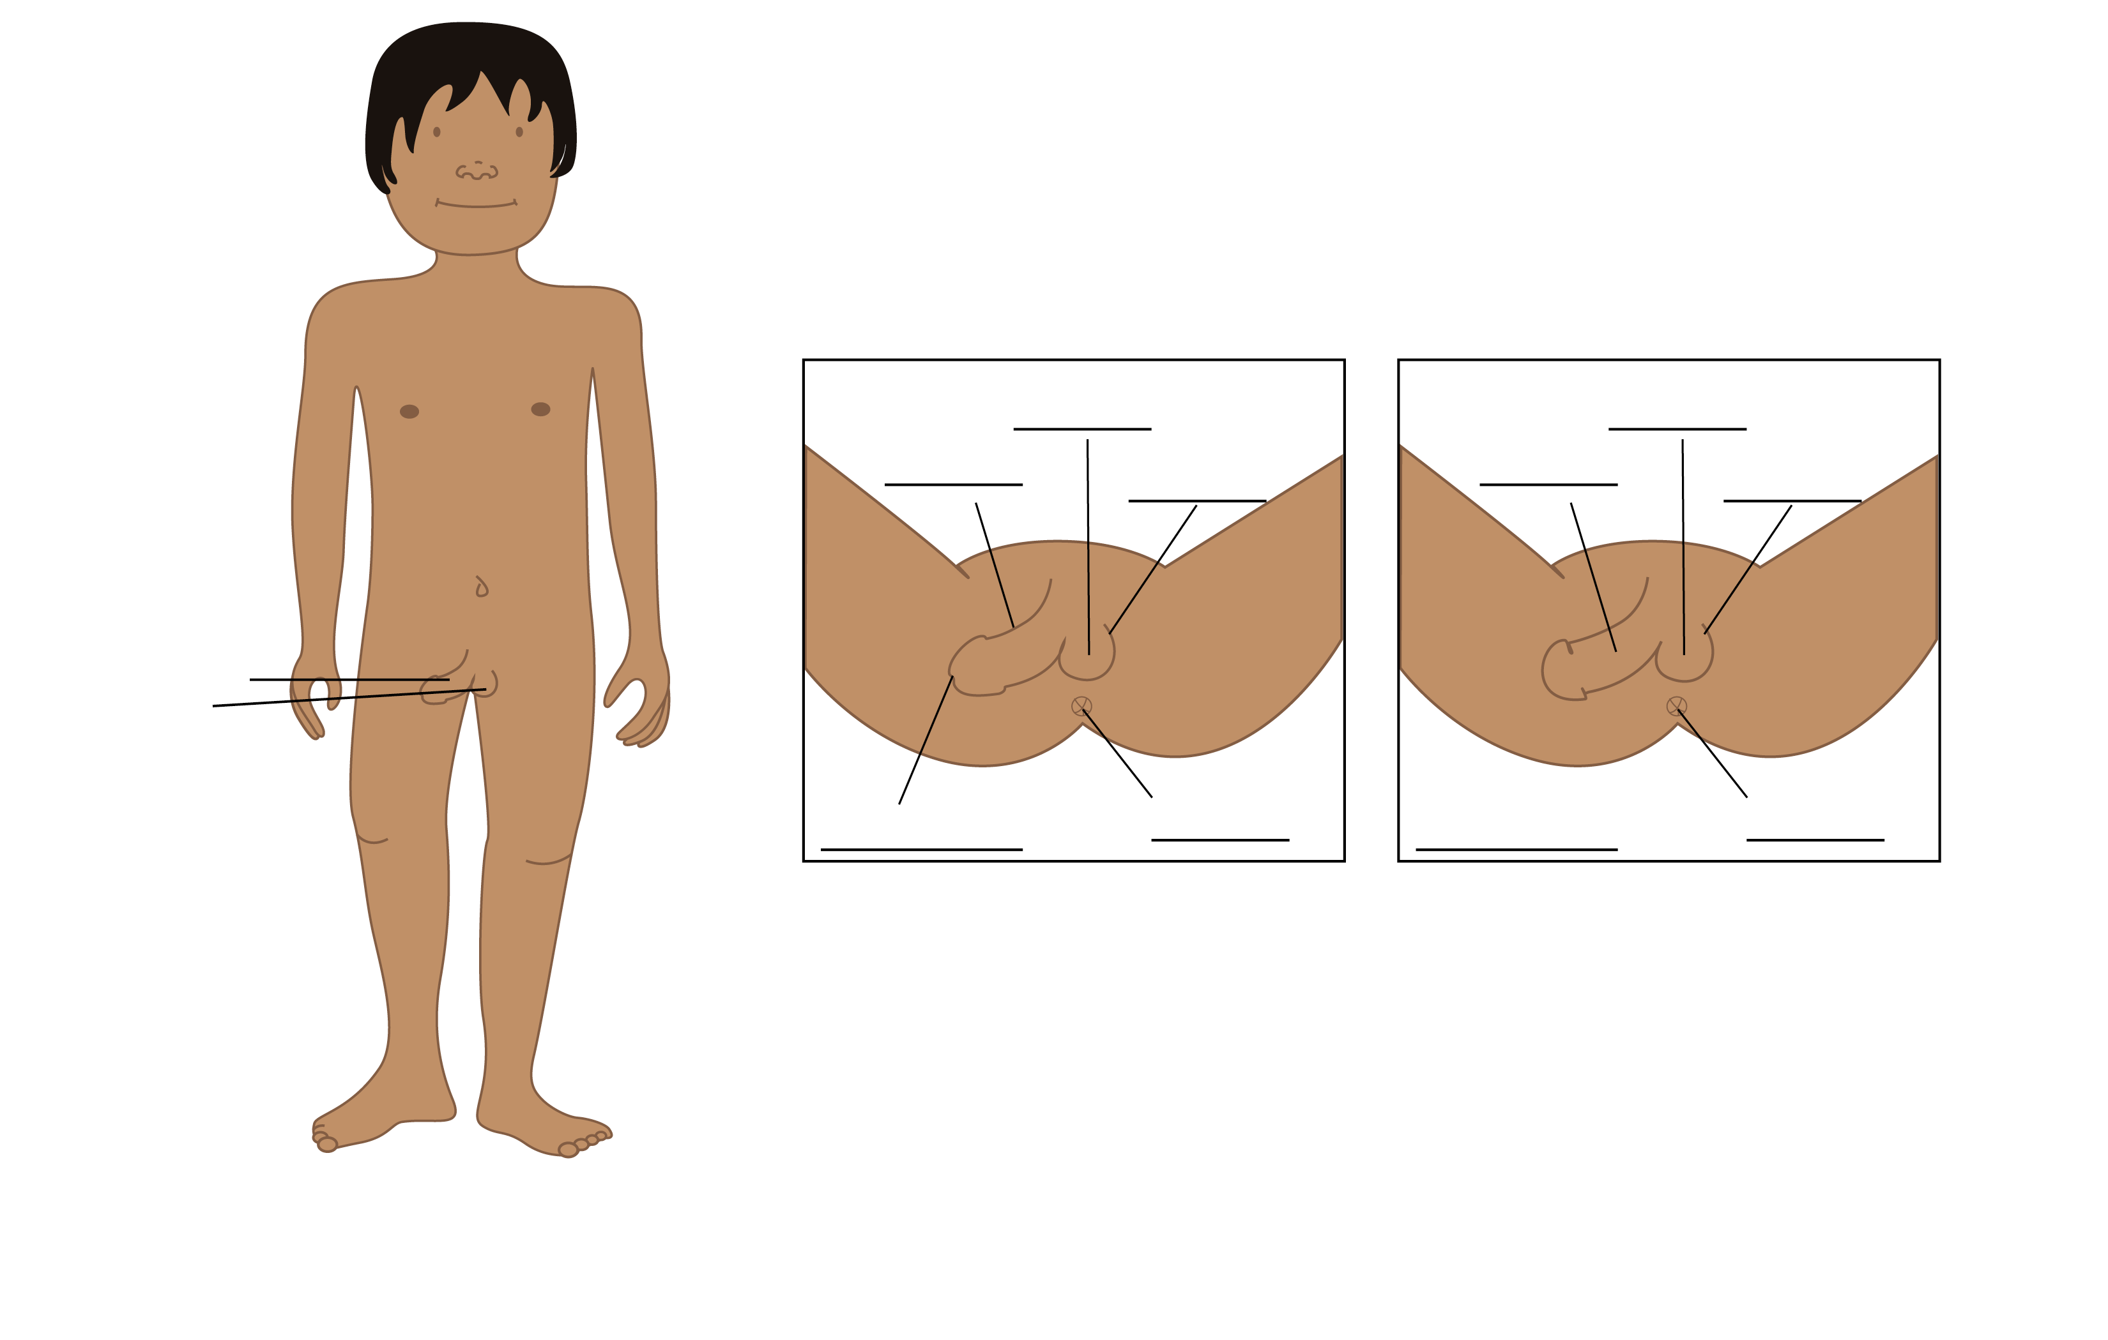
Boys and people with a penis
intact/uncircumcised
circumcised

Slide 8
What do you remember?
Can you name a body part that most girls and people with vulvas have?
  vagina, clitoris, vulva
Can you name a body part that most boys and people with a penis have?
  penis, testicle, scrotum
Can you name a body part that both types of bodies have?
  urethra, anus, nipples

Slide 9

All bodies have value and
All bodies deserve care

Slide 10

Who else can you talk to… a trusted adult
Finding An Adult That You Can Trust

Slide 11
Who can you talk to?
Parent or Guardian
School Counselor
School Nurse
Teacher
Faith Based Leader
Health Clinic
Health Care Provider
Other Trusted Adult

Slide 12
Why is it important to know the correct names of your body parts
So you can explain to a trusted adult if something is wrong or not feeling right.

